Slide 1
SQL PROJECT PRESENTATION

Slide 2
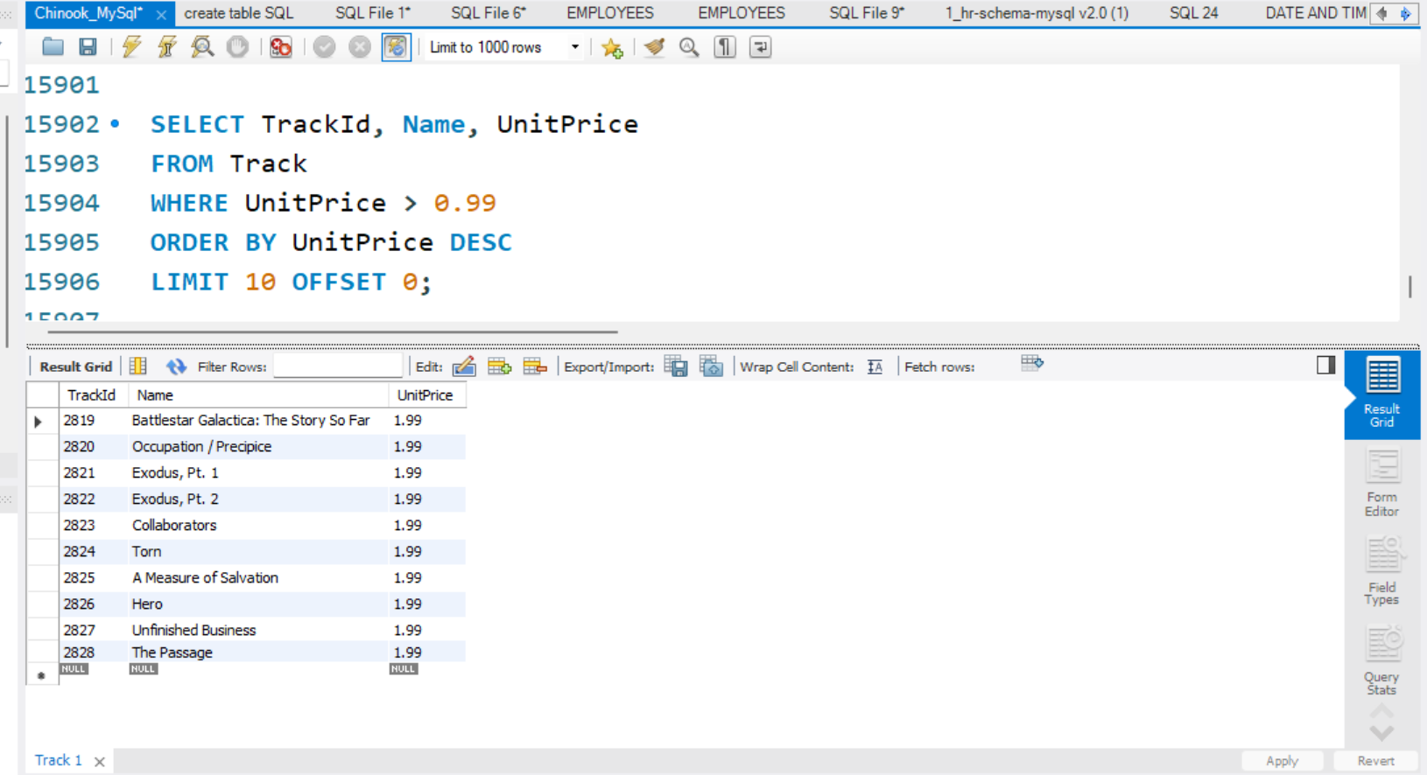
1. Basic SELECT / FROM / WHERE
The result displays the top 10 tracks from the Track table that have a UnitPrice
greater than $0.99 sorted from highest to lowest price

Slide 3
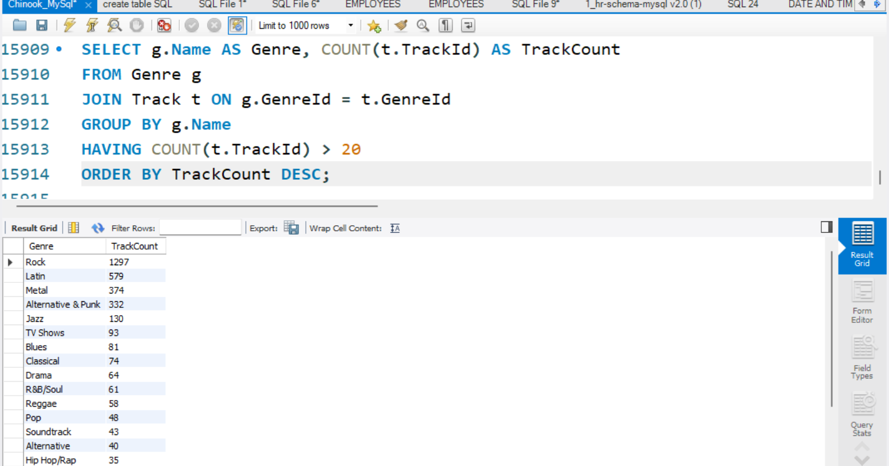
2. GROUP BY + HAVING
This query returns a list of genres that have more than 20 tracks sorted by the number of tracks in descending order

Slide 4
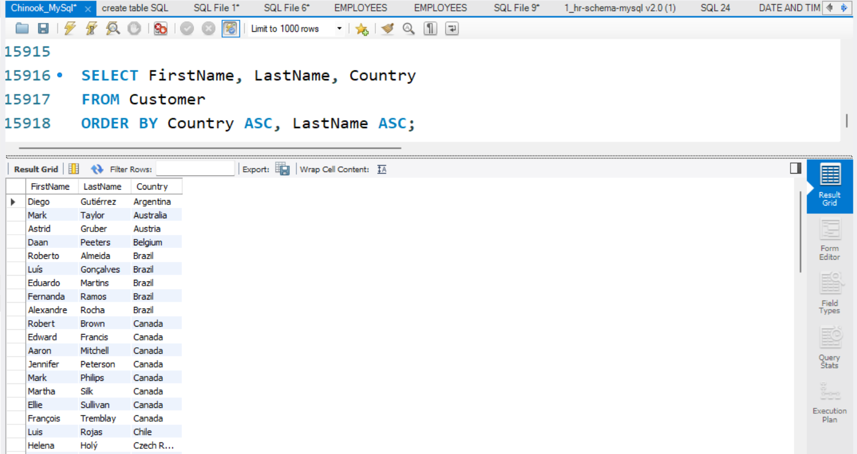
3.ORDER BY multiple columns
The result lists customers showing their FirstName LastName Country and sorted alphabetically by country

Slide 5
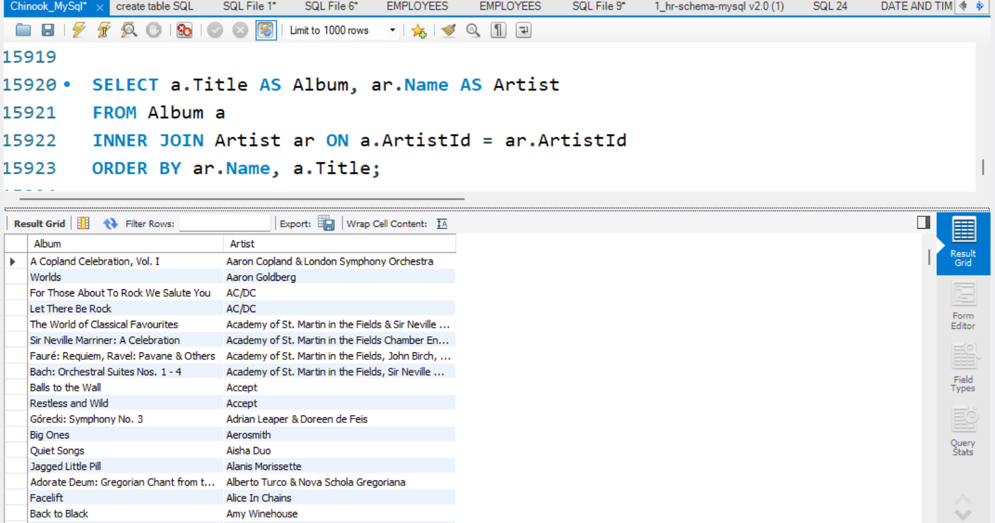
4.INNER JOIN
the query retrieves a list of album titles and artist names and uses inner join to
Combine Album and artist

Slide 6
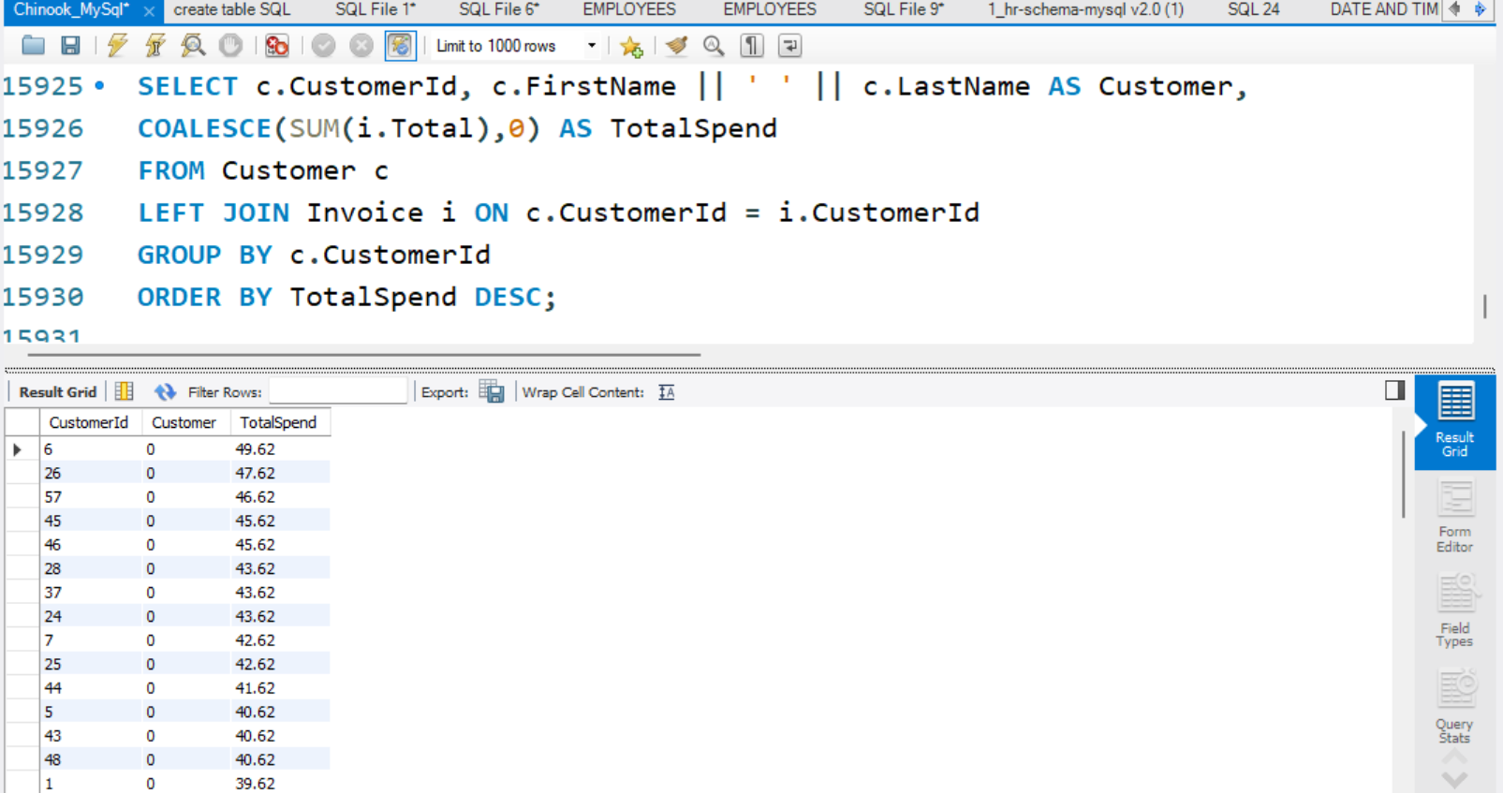
5. LEFT JOIN
retrieving a list of customers along with their total spending and uses left join to
Ensure all customers are included

Slide 7
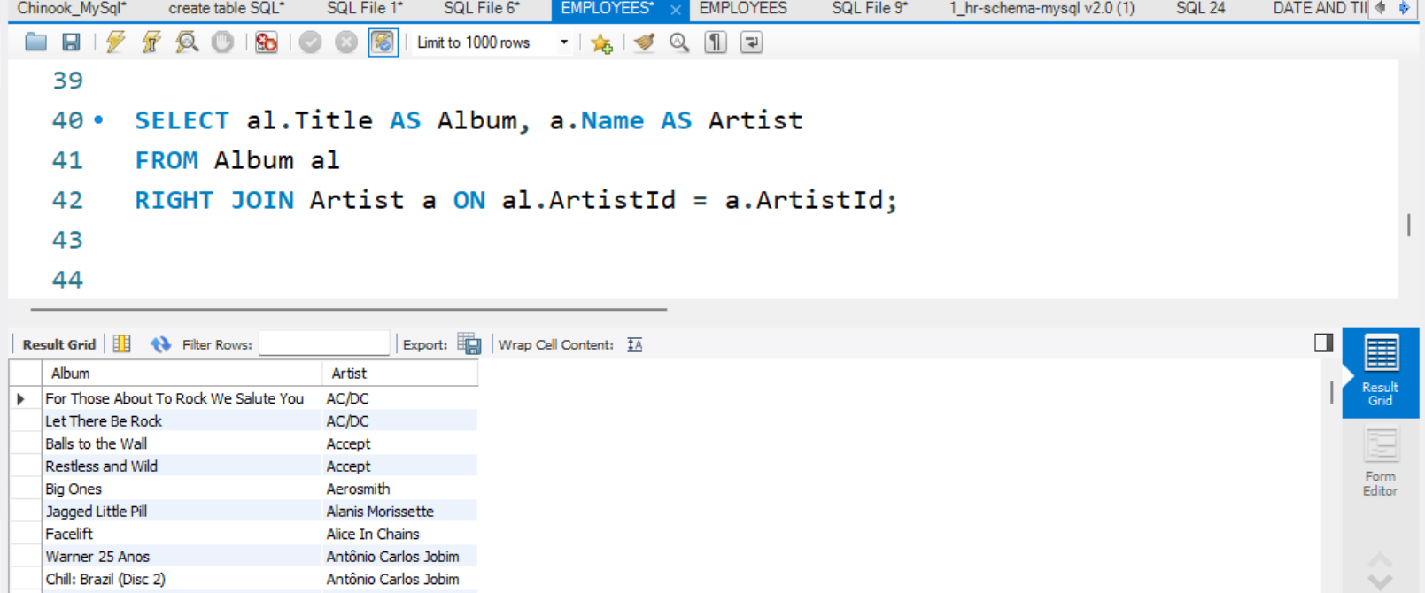
6.RIGHT JOIN
Each artist is paired with one or more albums it's a RIGHT JOIN if any
artist had no albums they would still appear

Slide 8
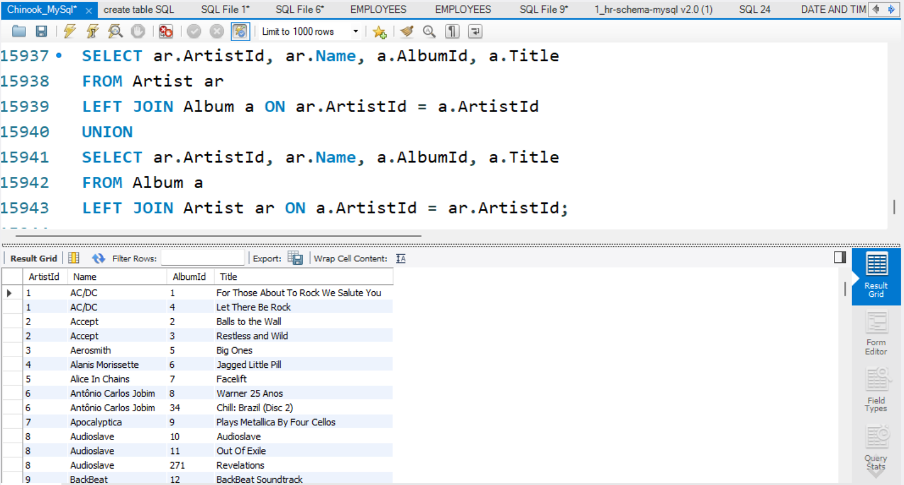
7.FULL OUTER JOIN
The query uses a UNION of two LEFT JOIN operations between the Artist and Album tables

Slide 9
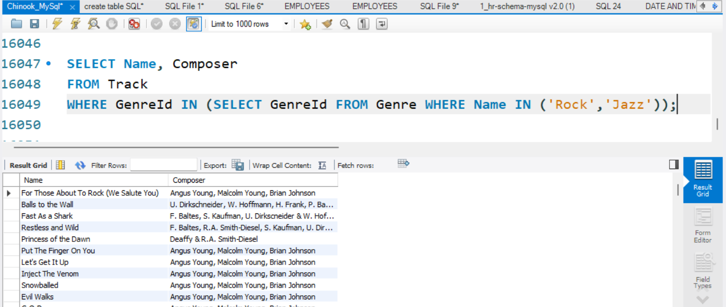
8.Multi-row subquery(in)
retrieves track names and composers for all tracks that belong to either the Rock or Jazz genres

Slide 10
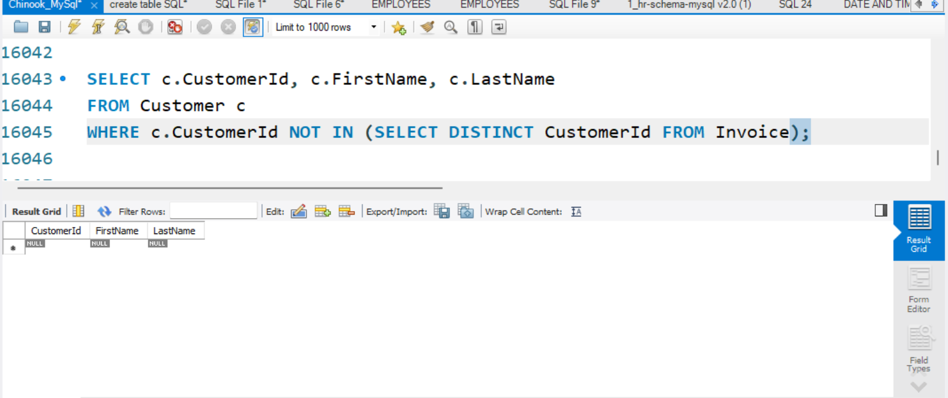
9.Multi-row subquery (NOT IN)
identifies customers who have never made a purchase whose Customer Id does not appear in the Invoice table

Slide 11
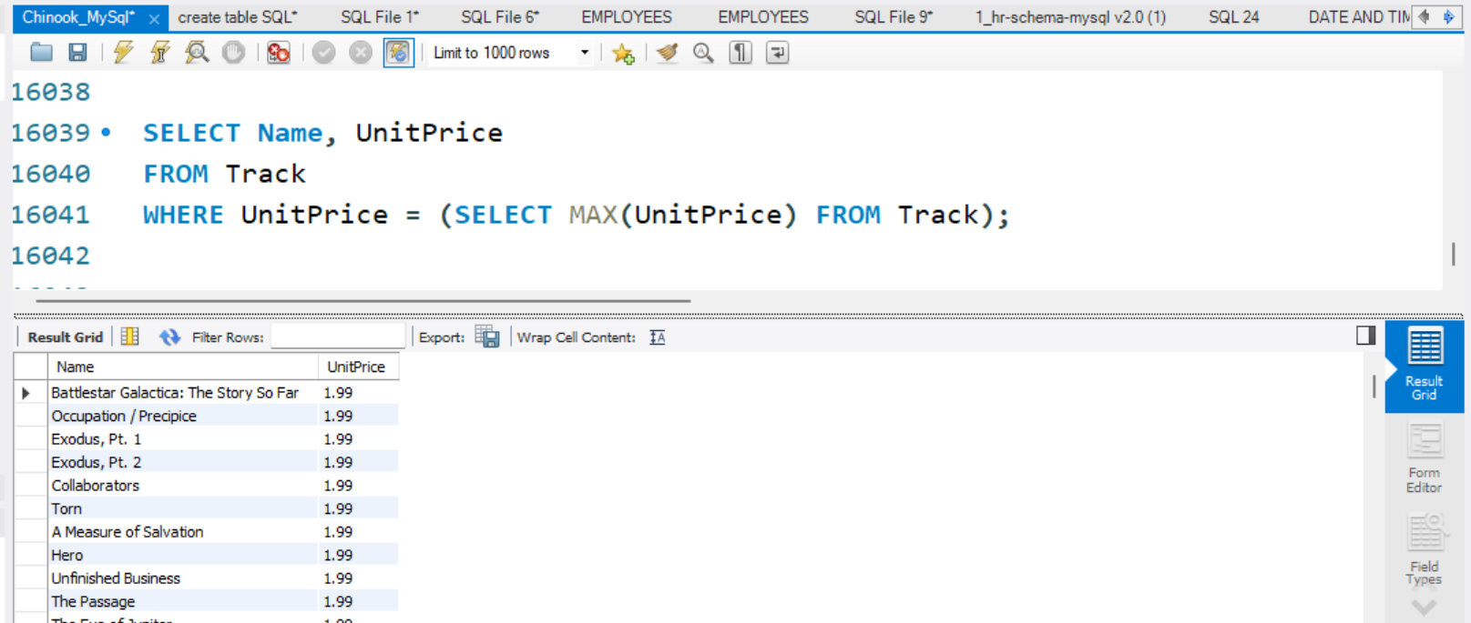
10. Single-row subquery
Tracks with a unit price of 1.99, which is the maximum price in the dataset

Slide 12
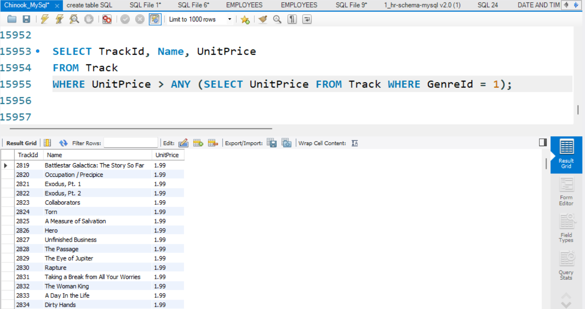
11. ANY
Tracks priced higher than at least one Rock track All returned tracks have a
Unit Price of 1.99, which is the maximum price in the dataset

Slide 13
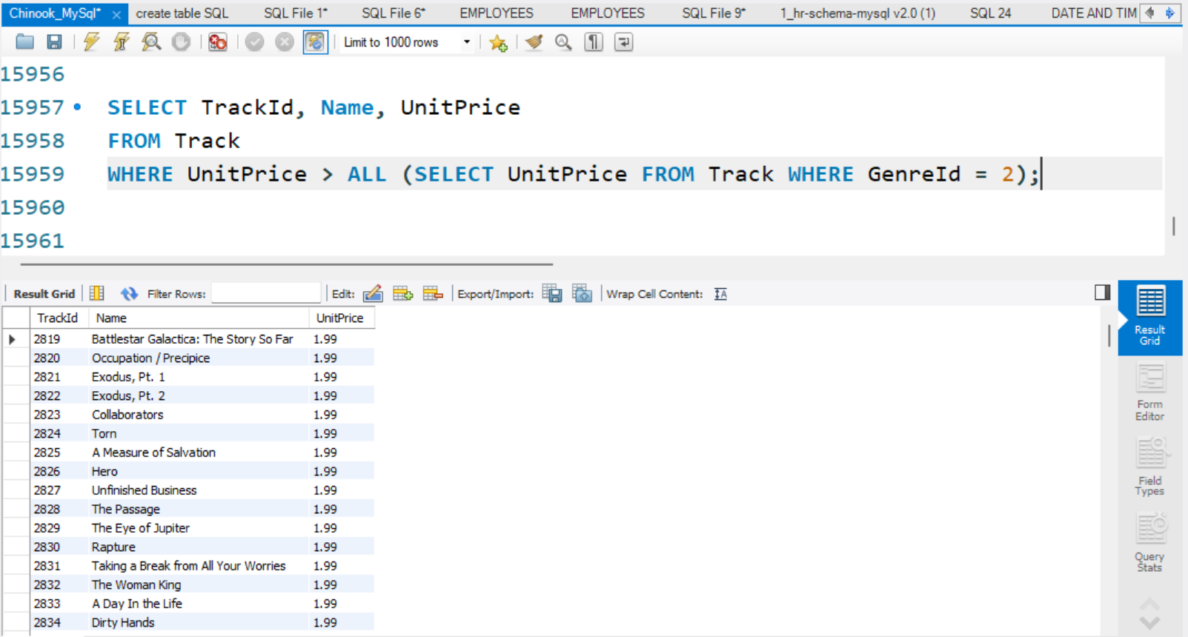
12. ALL
identifies tracks whose Unit Price is greater than all prices of tracks in GenreId = 2

Slide 14
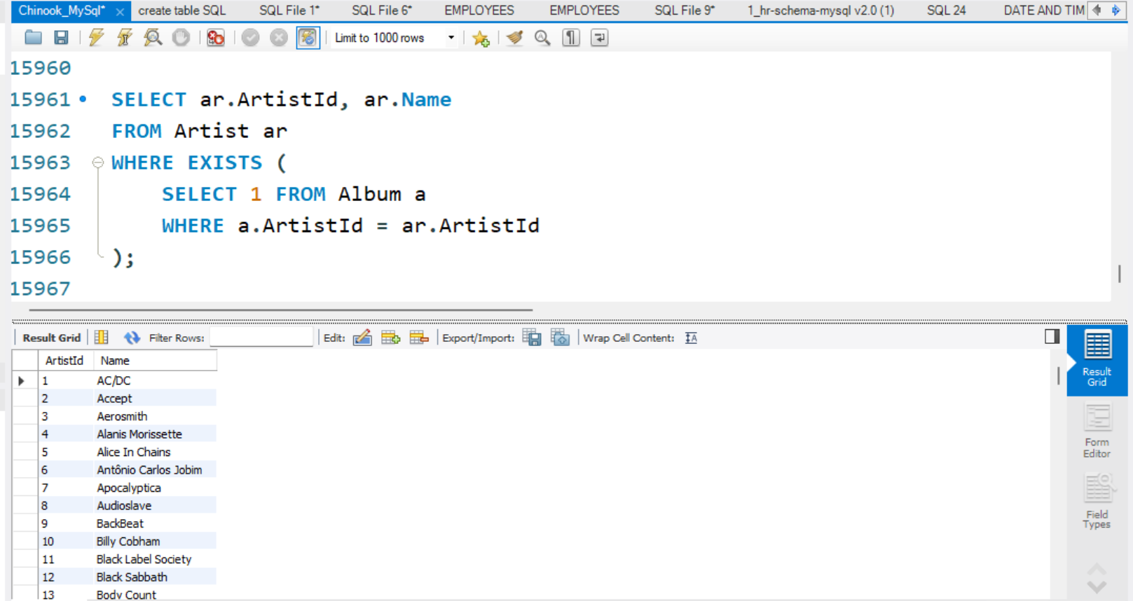
13. Correlated Subquery
retrieves all artists from the Artist table who have at least one album
in the Album table

Slide 15
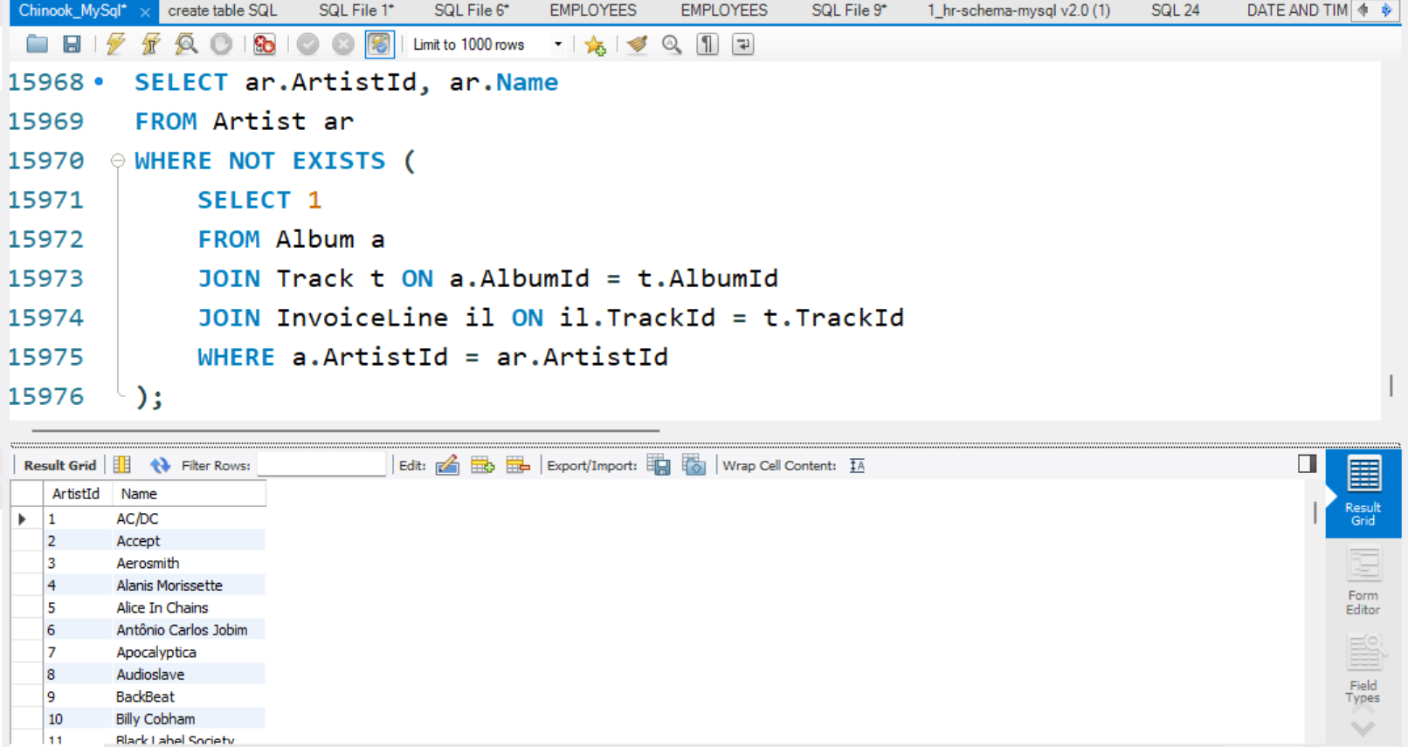
14. Correlated Subquery
identifies artists who do not have any tracks that appear in invoices artists whose music has never been purchased

Slide 16
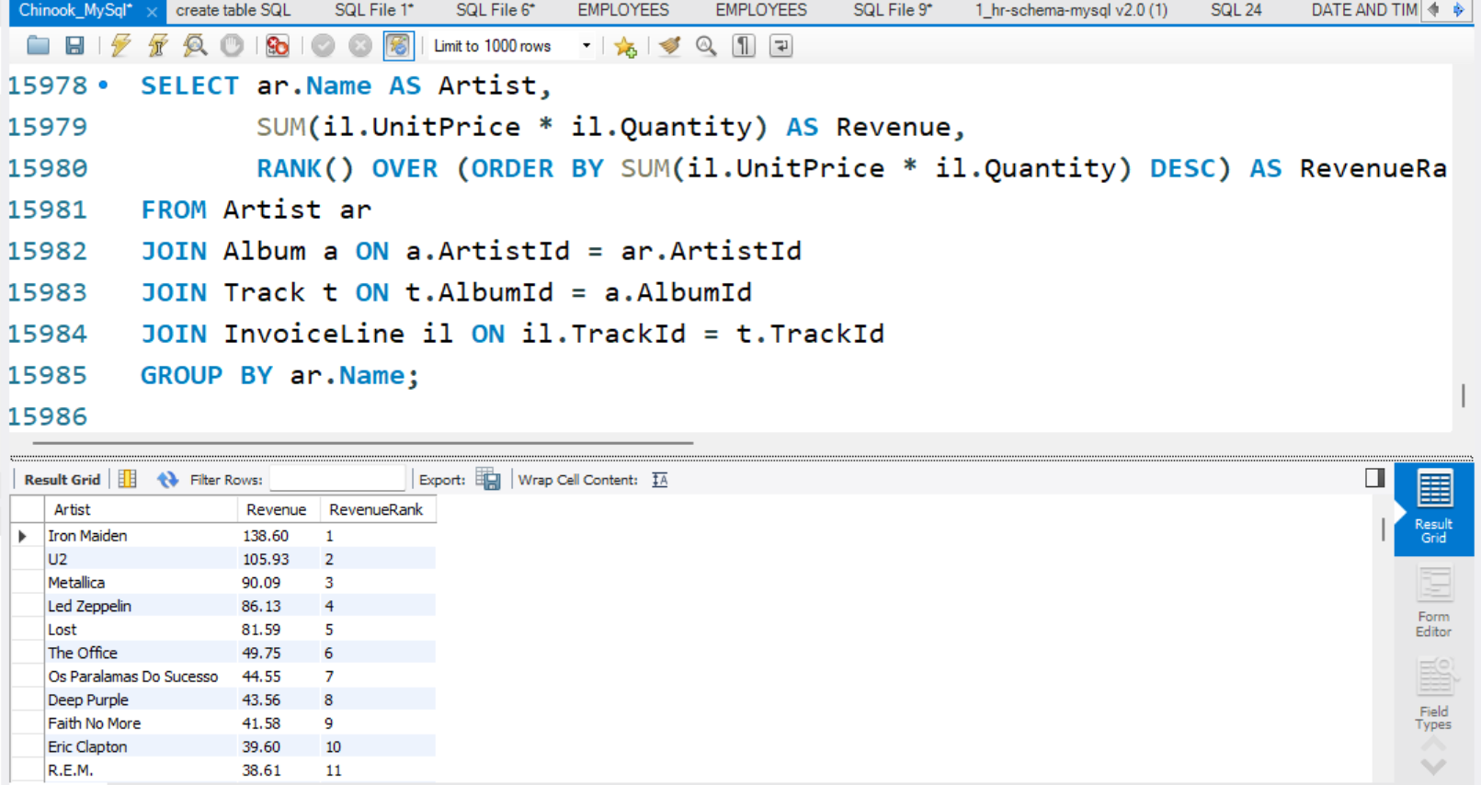
15. Ranking (RANK)
calculates the total revenue generated by each artist based on track sales, ranks them by revenue and displays the results in descending order

Slide 17
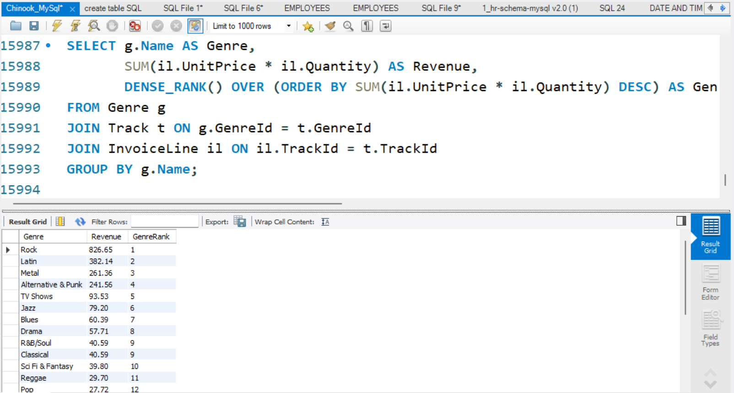
16. Dense Rank
calculates and ranks each genre based on that revenue total revenue by genre

Slide 18
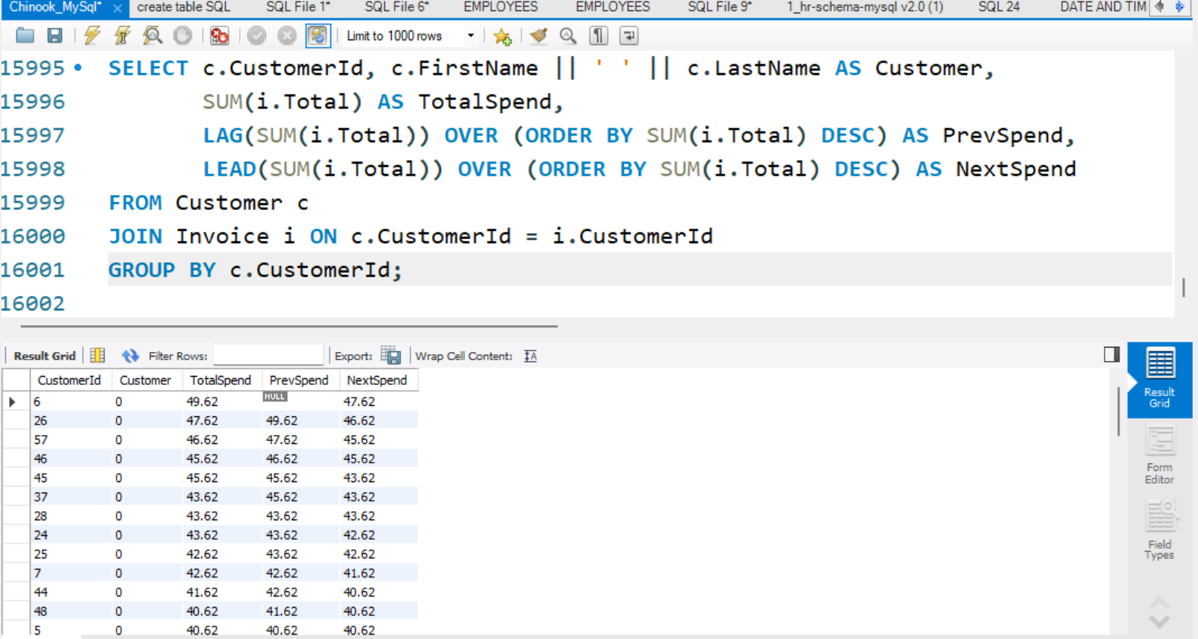
17. Lead / Lag
Calculating each customer's total spend Showing the previous and next spend
amounts relative to each customer in descending order of spend

Slide 19
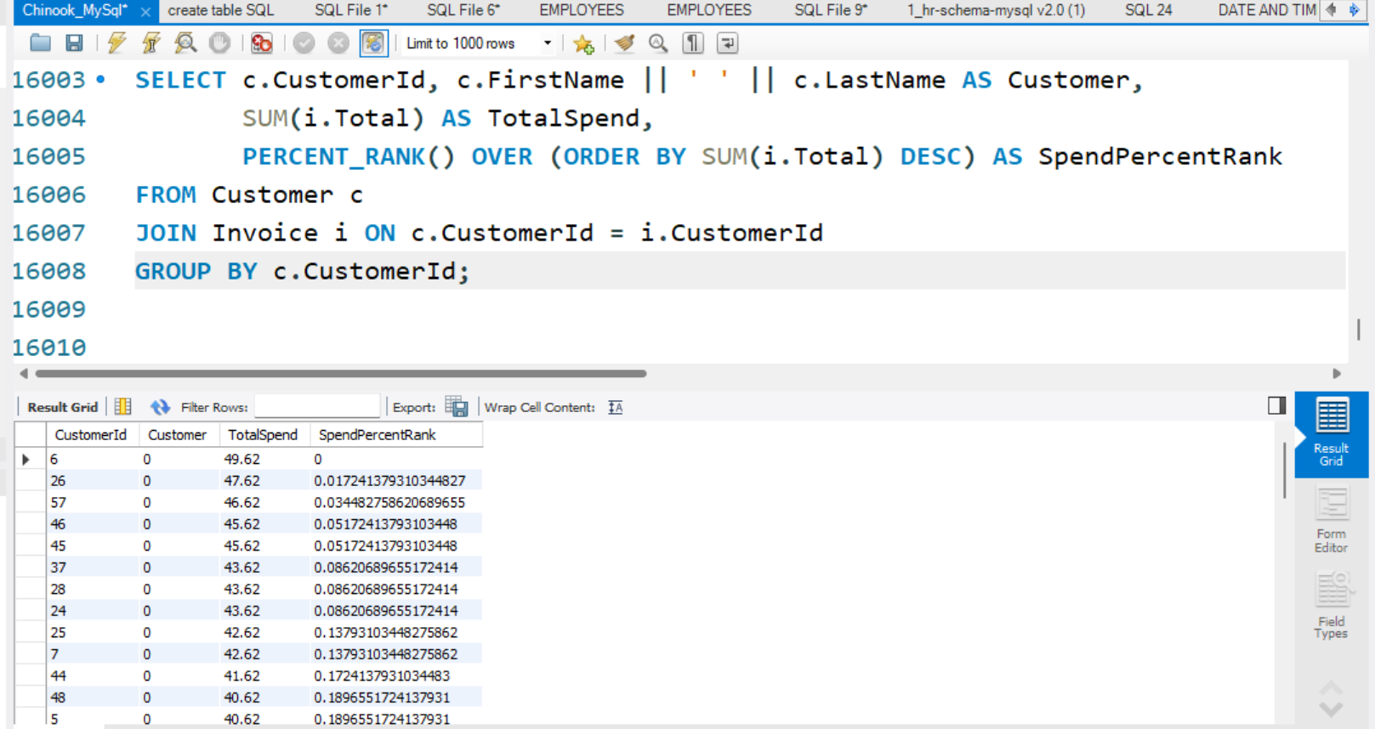
18. Percent Rank
rank customers by total spend using a percentile based approach showing how each customer compares to others in terms of spending

Slide 20
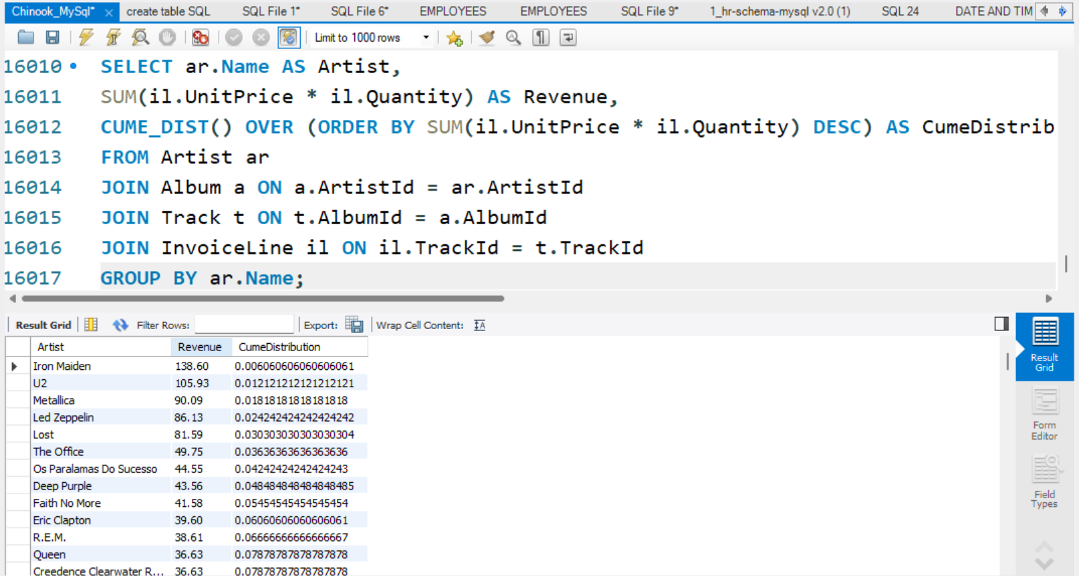
19. Cume Dist
To rank artists by total revenue and calculate the cumulative distribution of their earnings essentially showing how each artist compares to others in terms of revenue percentile

Slide 21
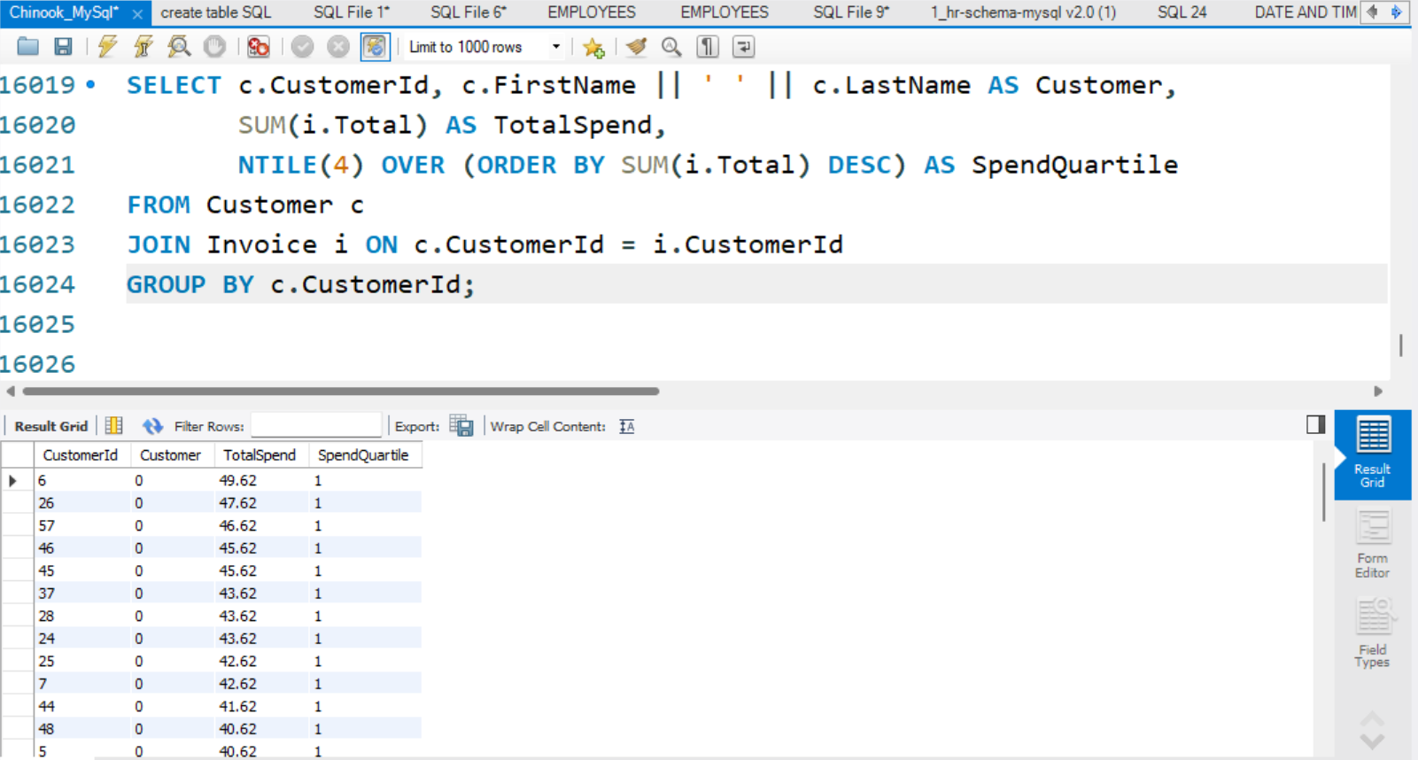
20. NTILE
To segment customers into spend quartiles based on their total purchases, helping identify top spenders and low spenders across four equal groups

Slide 22
THANK YOU

